Slide 1


Data Augmentation-Based Long-tailed Learning

Slide 2
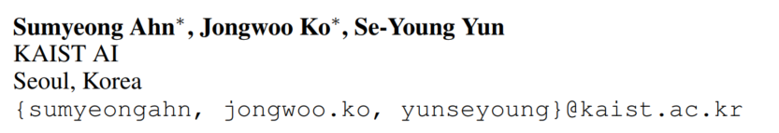
CUDA: Curriculum of Data Augmentation for Long-tailed Recognition
ICLR 2023

Slide 3
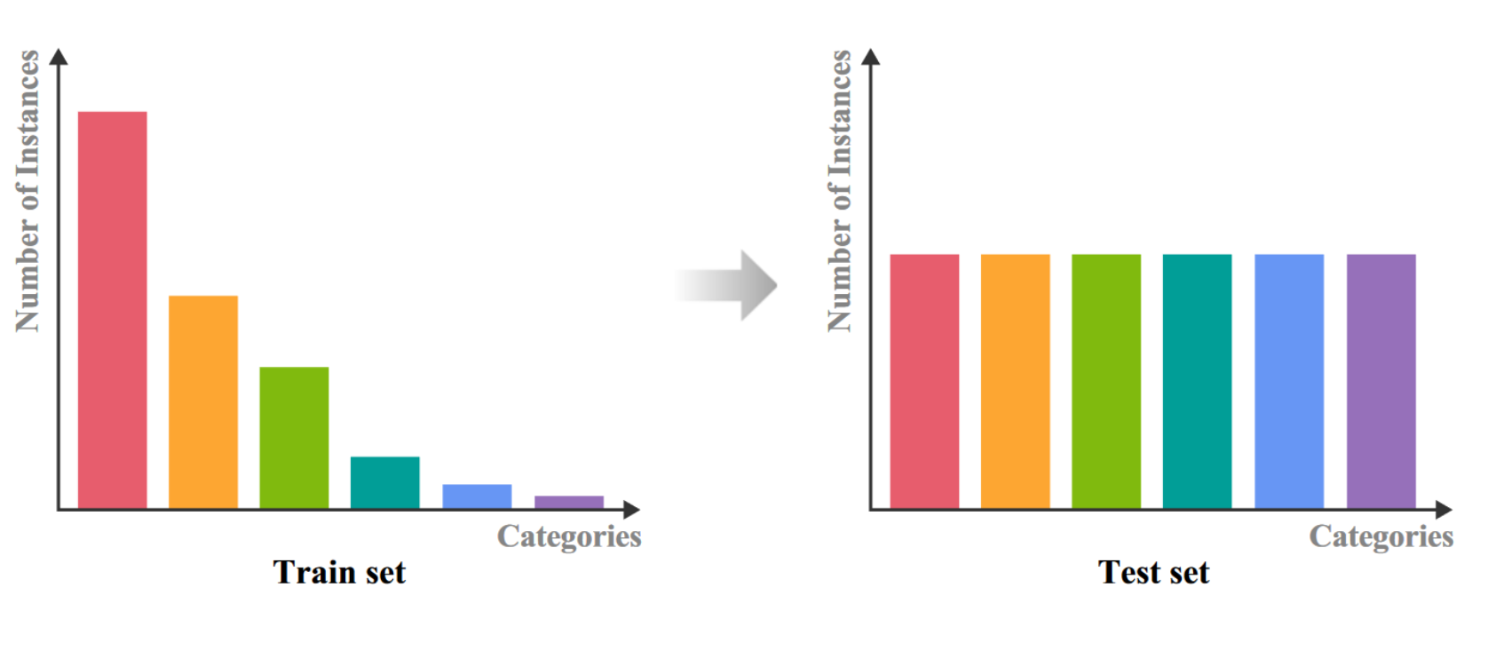
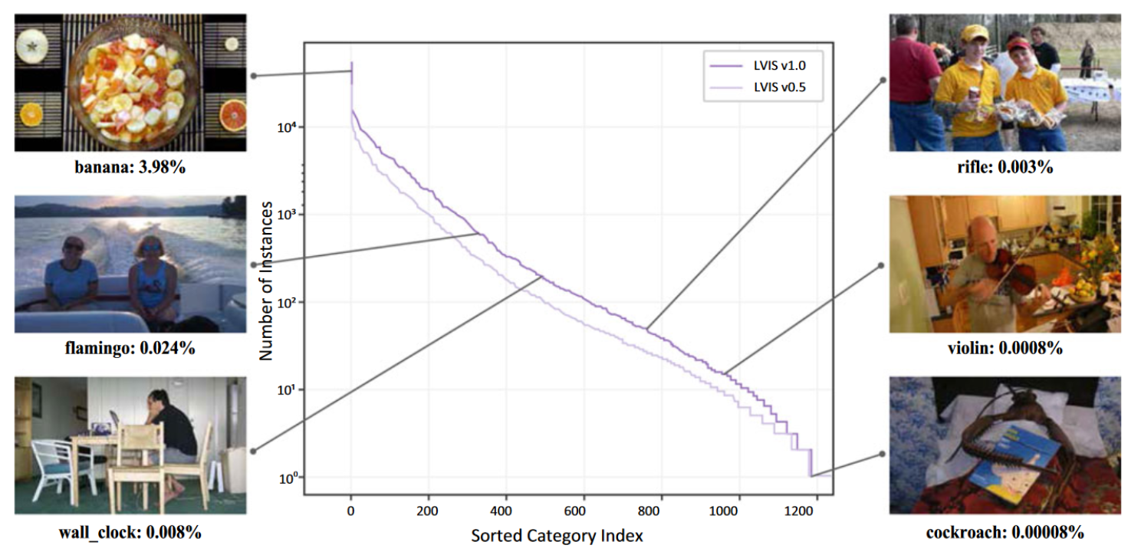
Background
Long-tailed Recognition
Examples of LVIS Dataset

Slide 4
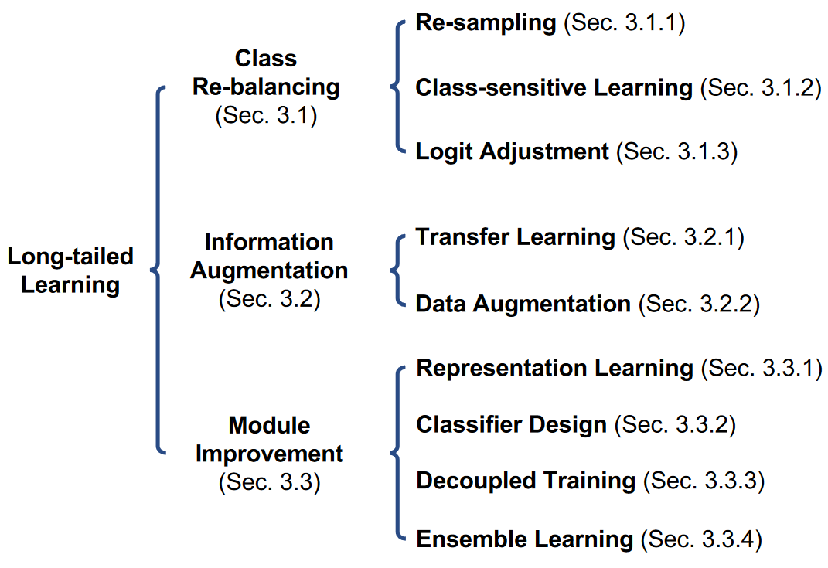
Background
Taxonomy of existing deep long-tailed learning methods^{[1]}
[1] Zhang Y, Kang B, Hooi B, et al. Deep long-tailed learning: A survey[J]. IEEE Transactions on Pattern Analysis and Machine Intelligence 2023.

Slide 5
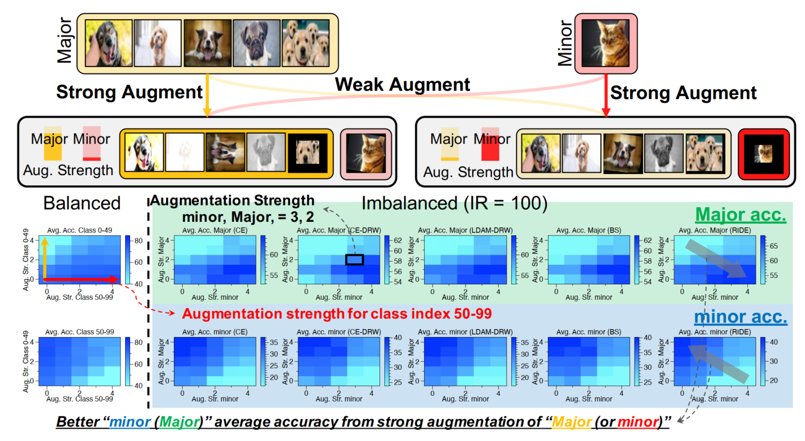
Motivation
Few works have considered the influence of the degree of augmentation of different classes on class imbalance problems.
Controlling the strength of class-wise augmentation:
Key Observation:
class-wise augmentation improves performance in the non-augmented classes while that for the augmented classes may not be significantly improved !
Notes:
许多工作探索了多种策略来为尾部类生成多样化的信息。尽管有许多方法利用数据增强生成关于少数样本的各种信息，但很少有工作考虑到不同类别增强程度对类别不平衡问题的影响。特别是，关于哪些类别应该增强以及增强的强度如何。

Slide 6
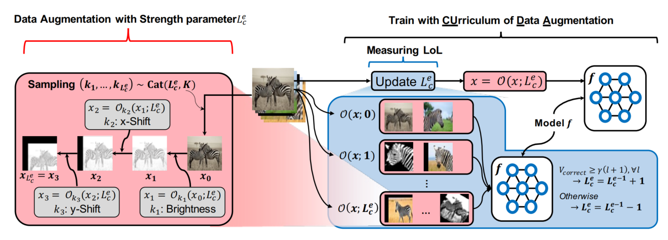
Methods
CUDA includes two parts:
a method to generate the augmented samples based on the given strength parameter;
(2) a method to measure a Level-of-Learning (LoL) score for each class.

Slide 7
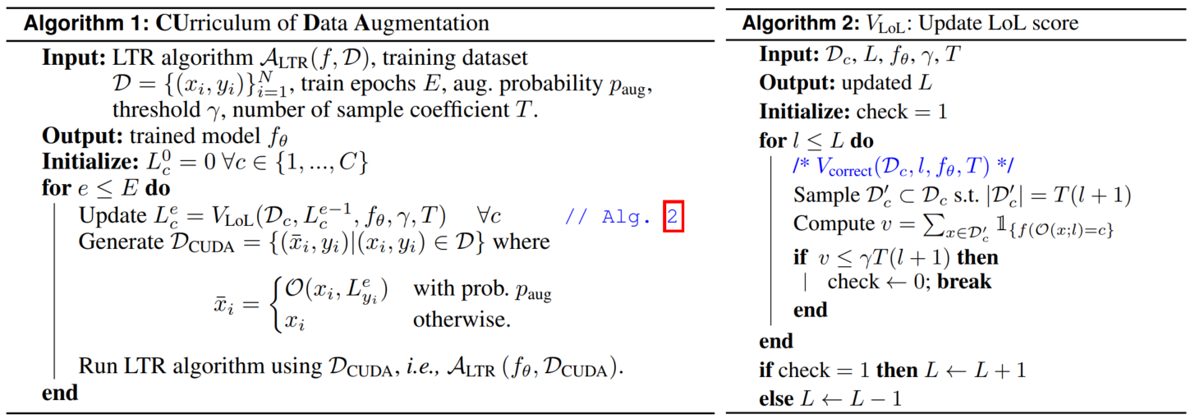
Alogrithm

Slide 8
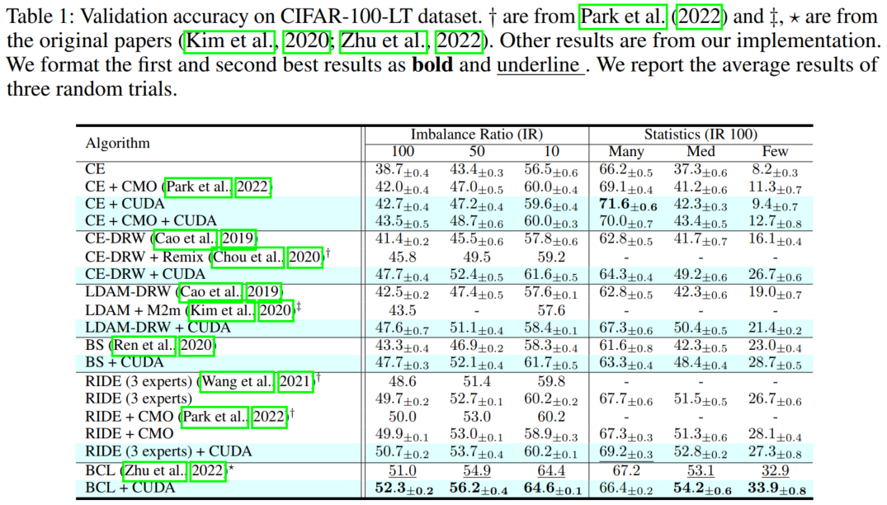
Experiment

Slide 9
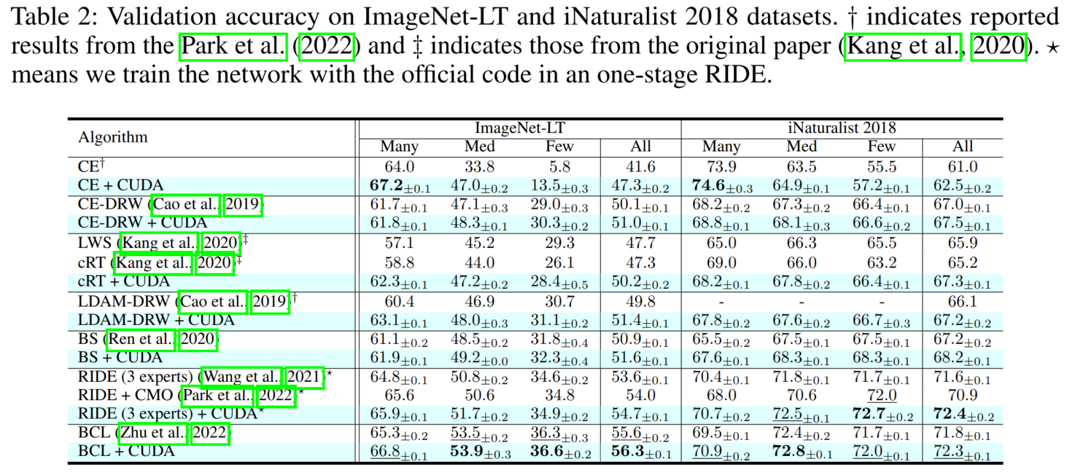
Experiment

Slide 10
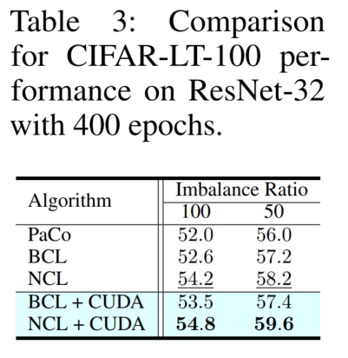
Experiment

Slide 11
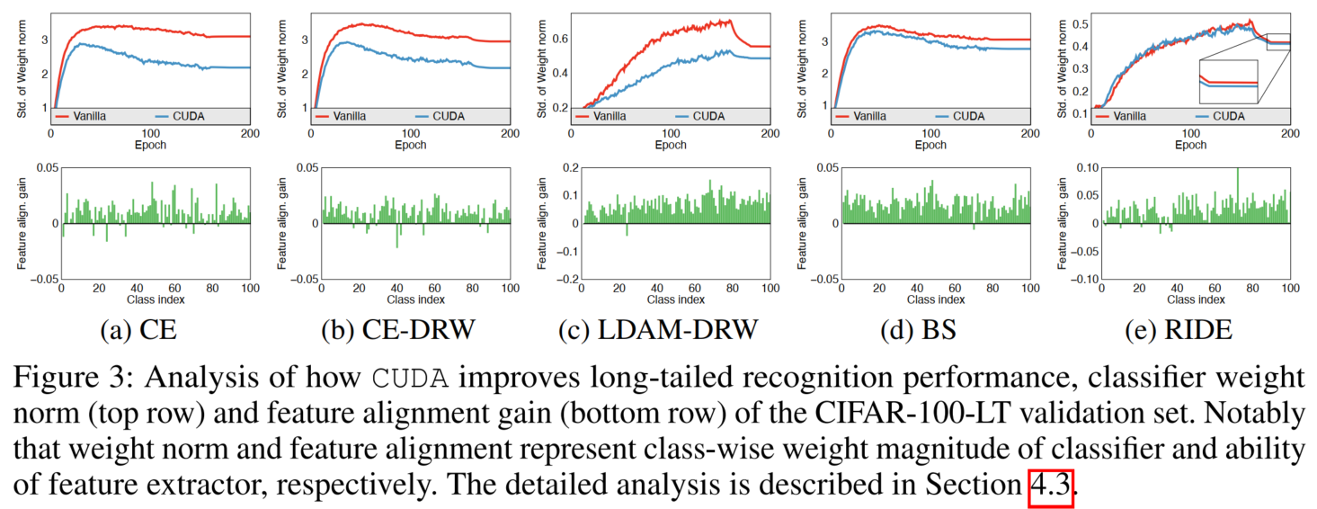
Analysis

Slide 12
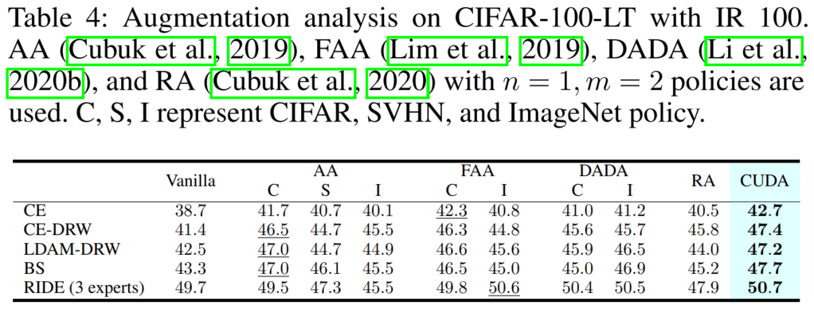
Experiment

Slide 13
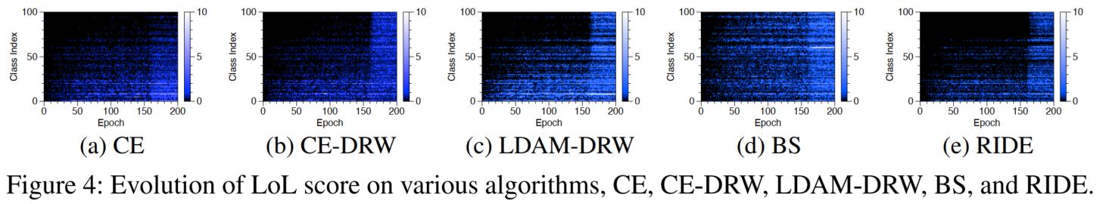
Experiment

Slide 14
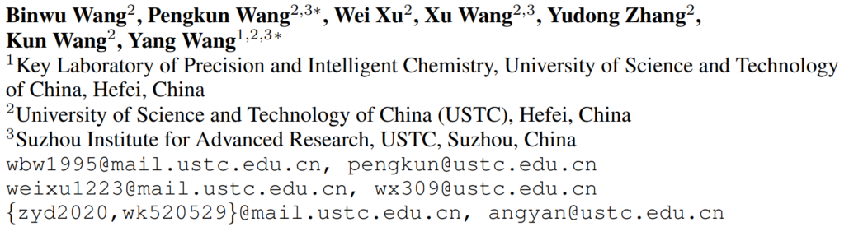
Kill Two Birds with One Stone: Rethinking Data Augmentation for Deep Long-tailed Learning
ICLR 2024

Slide 15
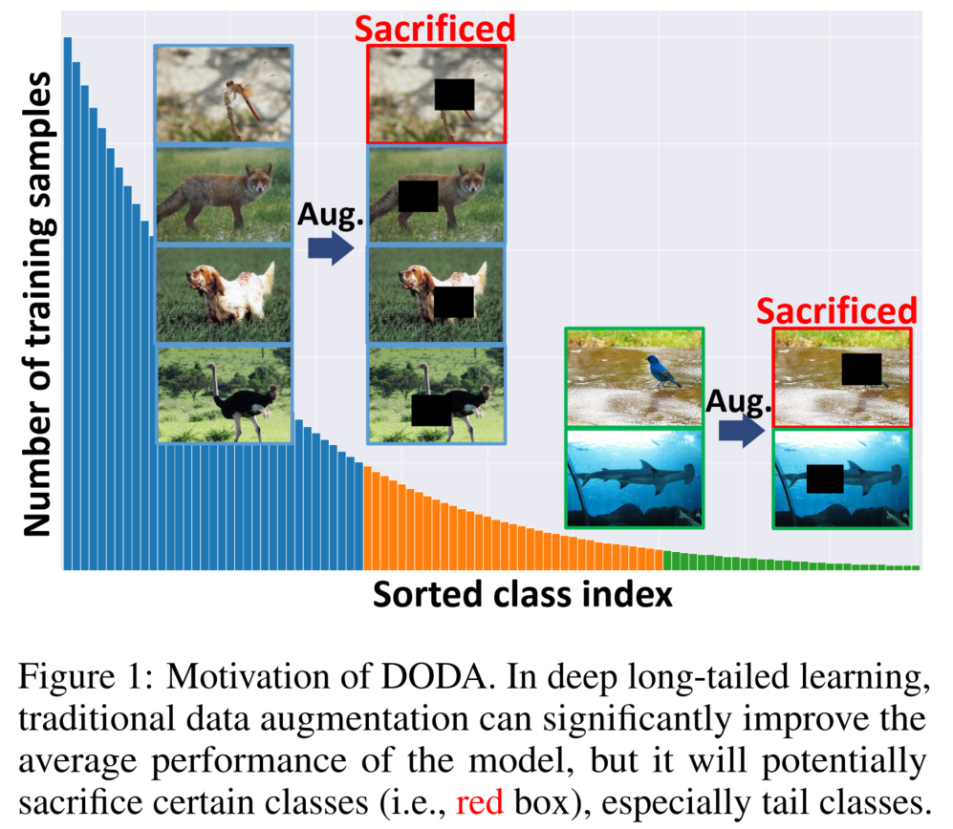
Motivation
Whether it is optimal to utilize the same kind of augmentation strategy on all classes for long-tailed learning.
Two ‘birds’ co-exist in long-tailed learning:
inherent data-wise imbalance;
extrinsic augmentation-wise imbalance.
The former is the inherent property of real-world data distributions, while the latter is the side effect caused by DA when improving model generalization.

Slide 16
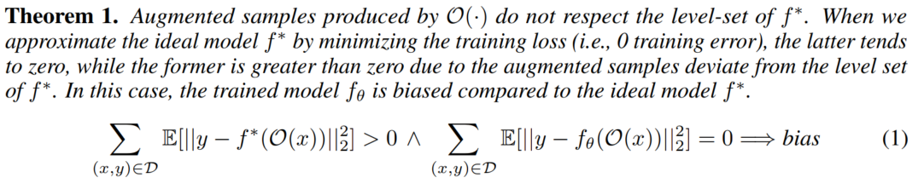
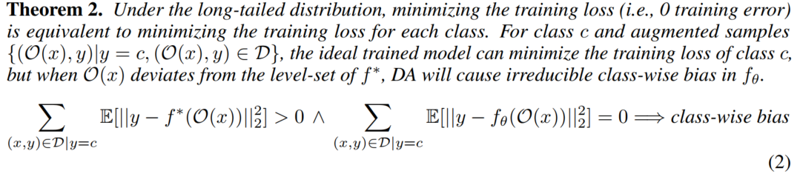
Analysis
This overall improvement is encouraging, but it also prompts us to think about how DA brings gains to the problem.

Slide 17
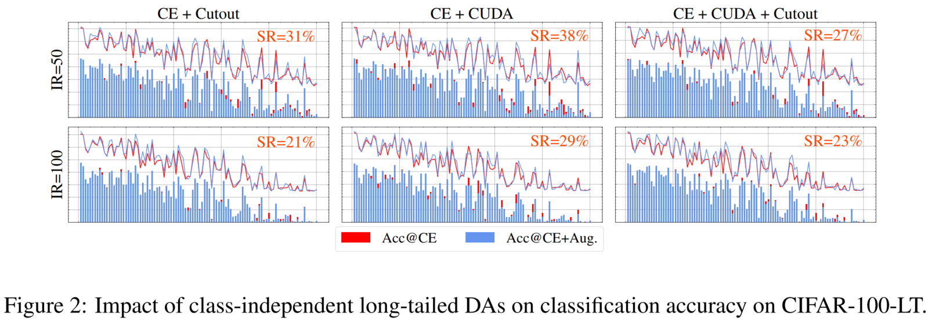
Analysis
Key Observations:
All three types of DA can improve the average model performance;
The improvement in average performance inevitably sacrifices some classes, whether they are head or tail classes;
The phenomenon of sacrificing classes is especially evident on tail classes.

Slide 18
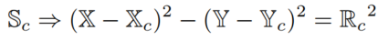
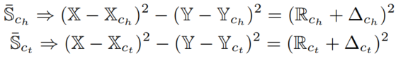
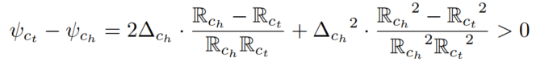
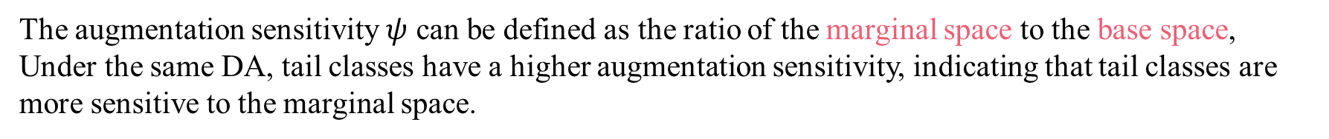
Analysis
DA demonstrates its effectiveness by pleasing the 'strong' and exploiting the 'weak’!
The distribution span can be expressed as follows:
The distribution span after DA can be defined as follows:
The augmentation sensitivity $ψ$ can be defined as the ratio of the marginal space to the base space, Under the same DA, tail classes have a higher augmentation sensitivity, indicating that tail classes are more sensitive to the marginal space.

Slide 19
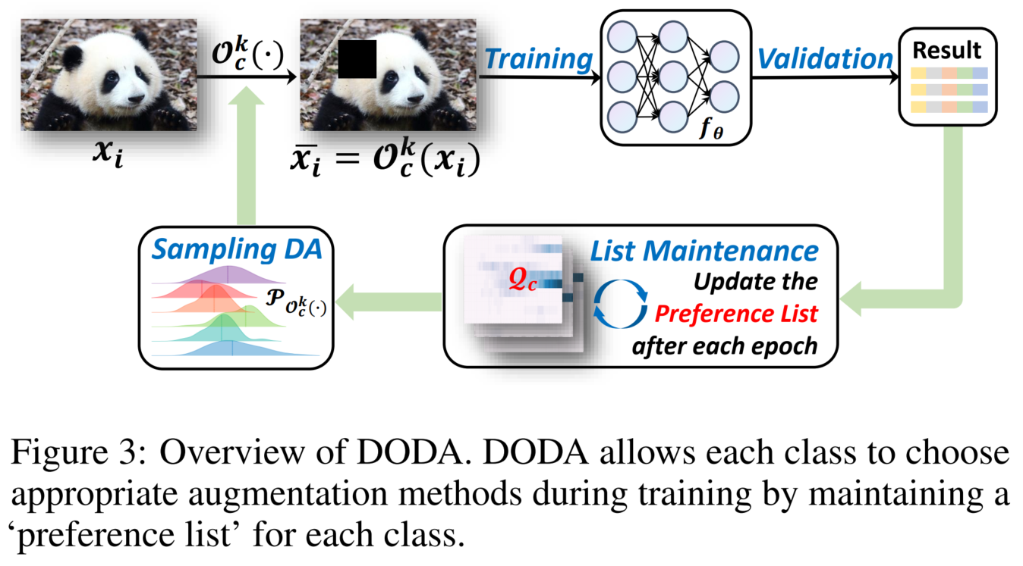
Methods

Slide 20
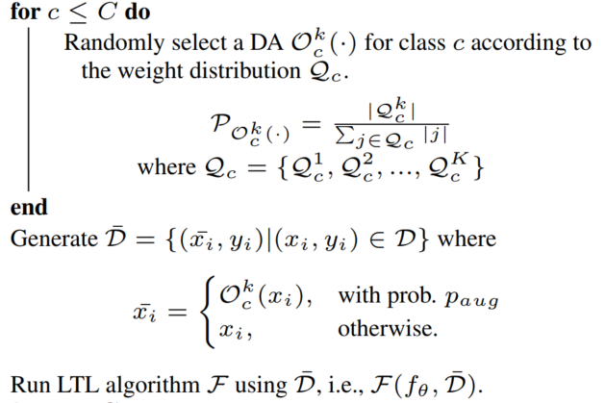
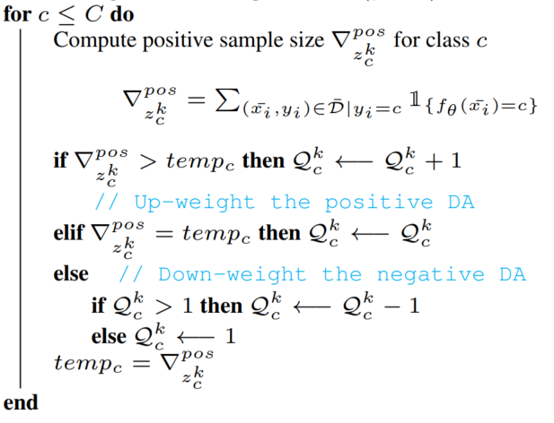
Methods

Slide 21
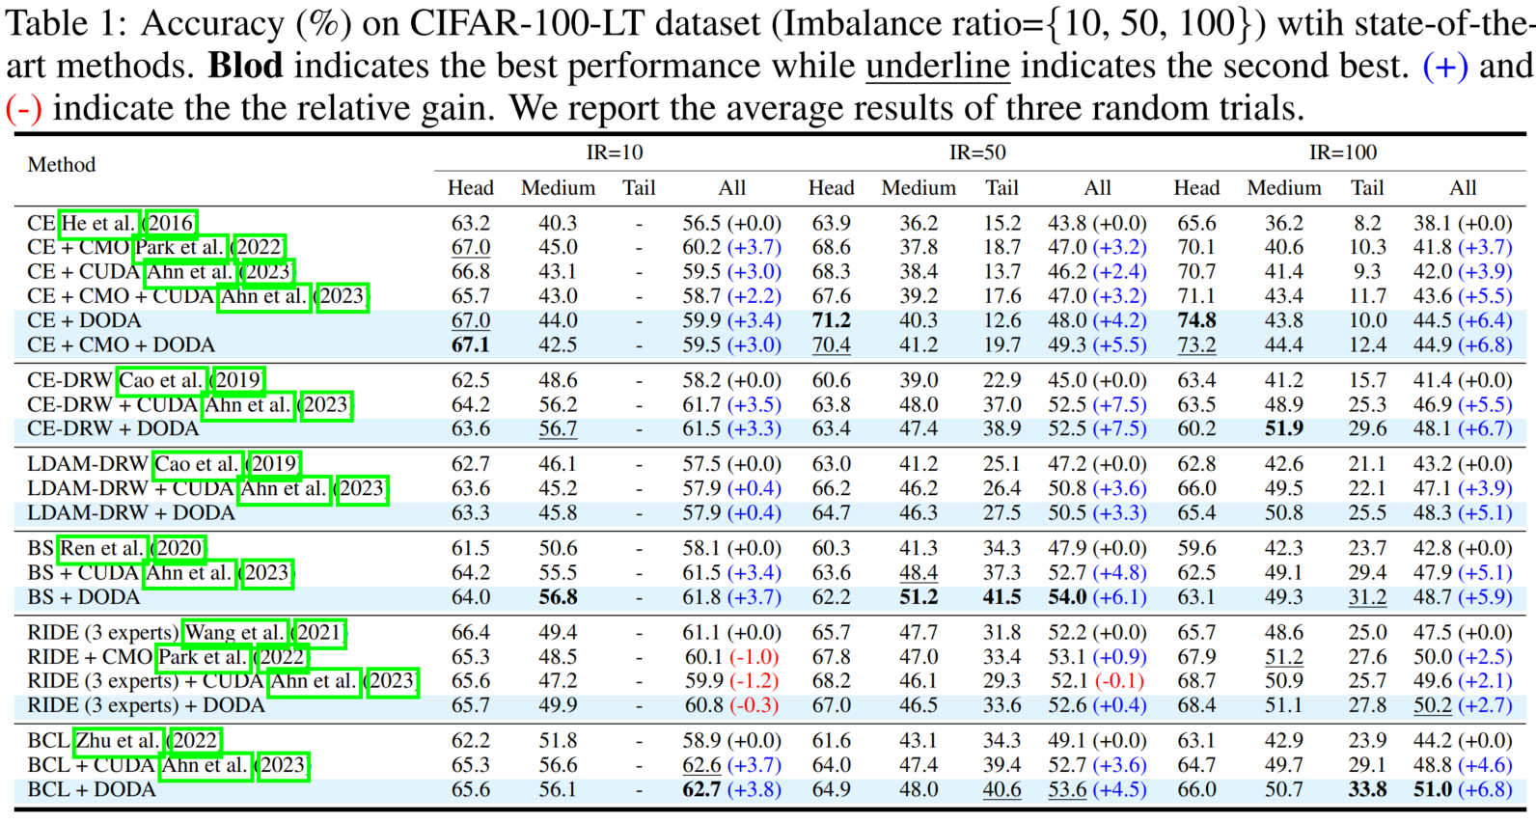
Experiment

Slide 22
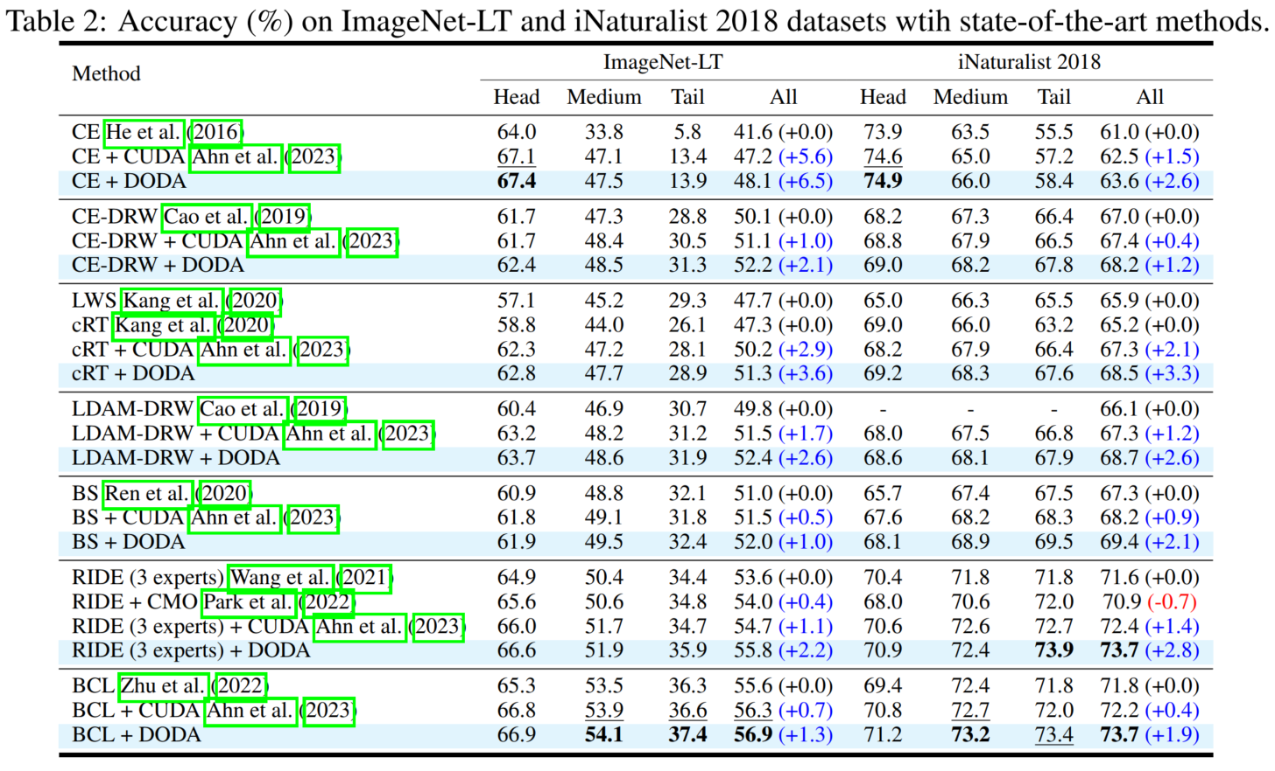
Experiment

Slide 23
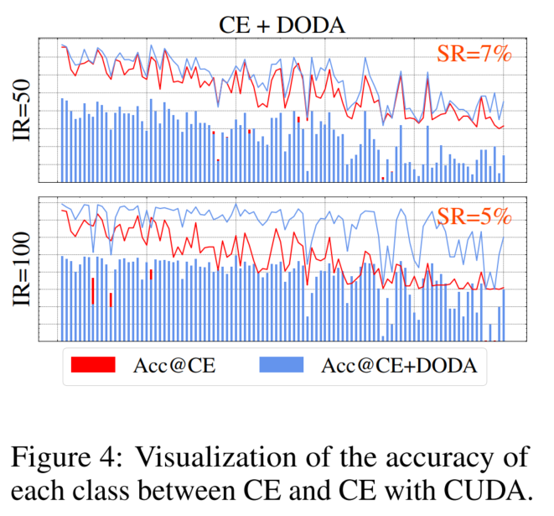
Experiment
Does DODA make fewer classes be ‘sacrificed’?

Slide 24
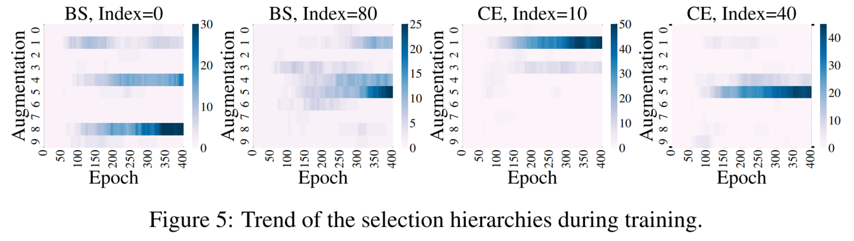
Experiment
Why DODA can alleviate the long-tailed problem?

Slide 25
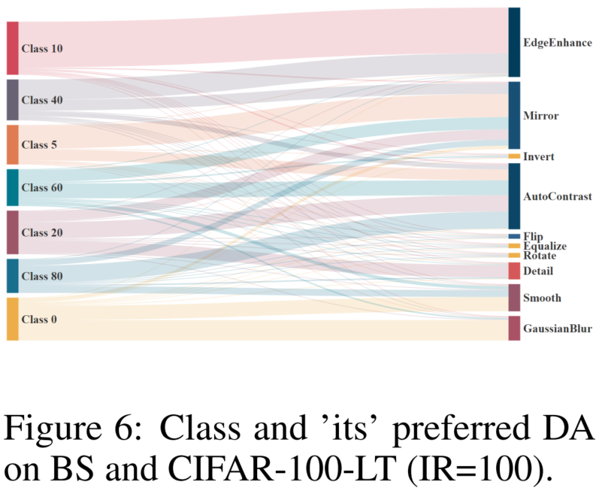
Experiment
What are the trends in DAs favored by classes?

Slide 26
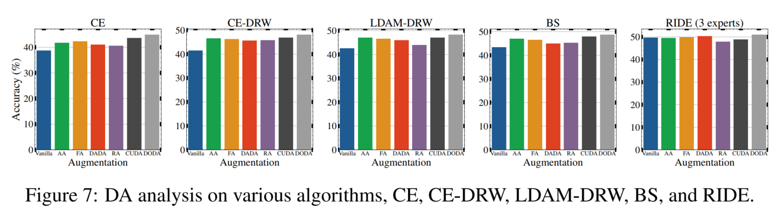
Experiment
Would other augmentation methods be better?

Slide 27
Thanks

Slide 28
